Slide 1
Bay Topology Discovery Packet

Slide 2
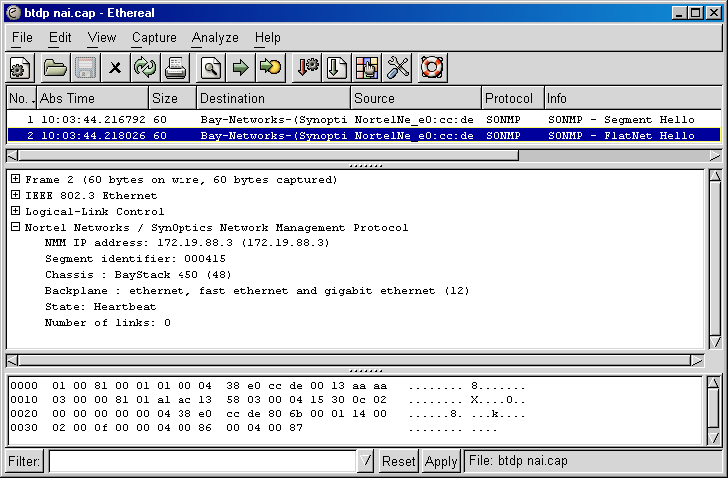
Ethereal v 0.10.0

Slide 3
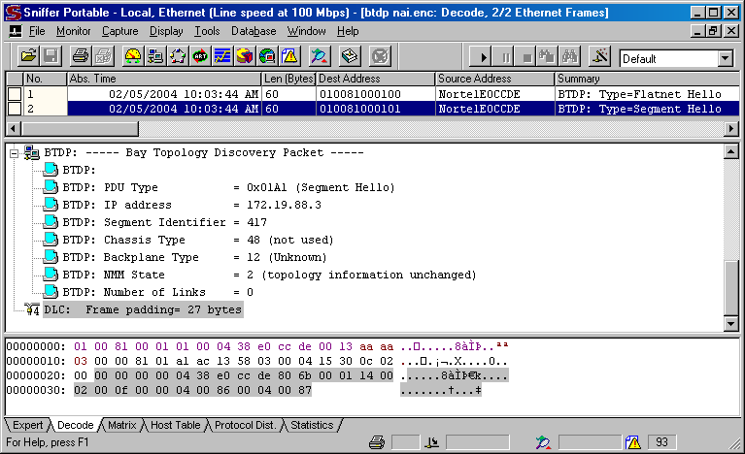
NAI Sniffer Pro v 4.70.537

Slide 4
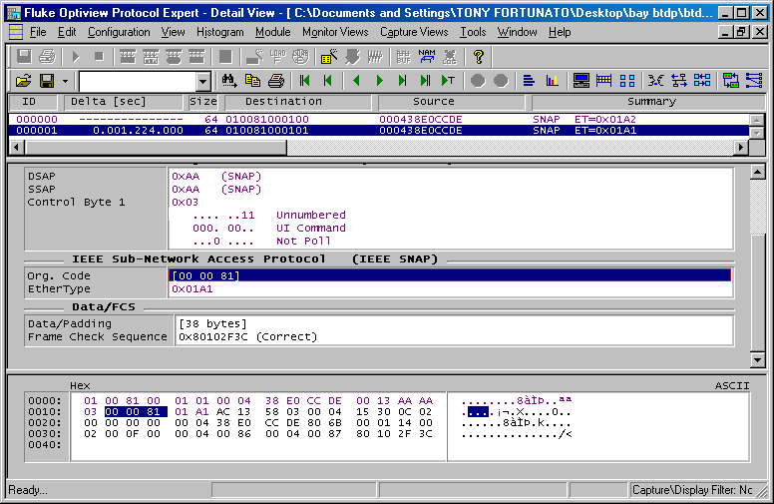
Optiview Protocol Expert v 5.0.2.264.4

Slide 5
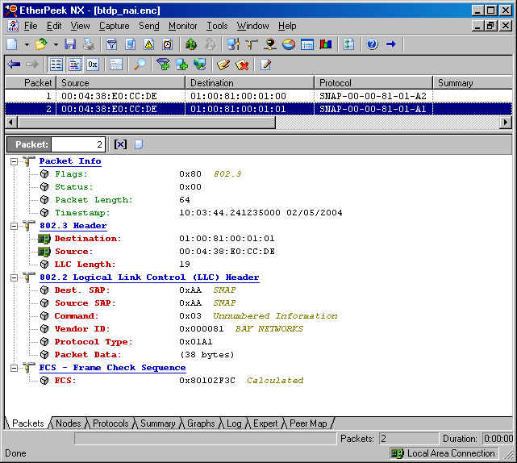
Wildpackets v 2.1

